Slide 1




Prepared by Archit Barua, Nikshita Ranganathan,
Heejae Roh, Shyamala Venkatakrishnan
Professor Venkata Duvvuri
March 29th, 2023

Slide 2
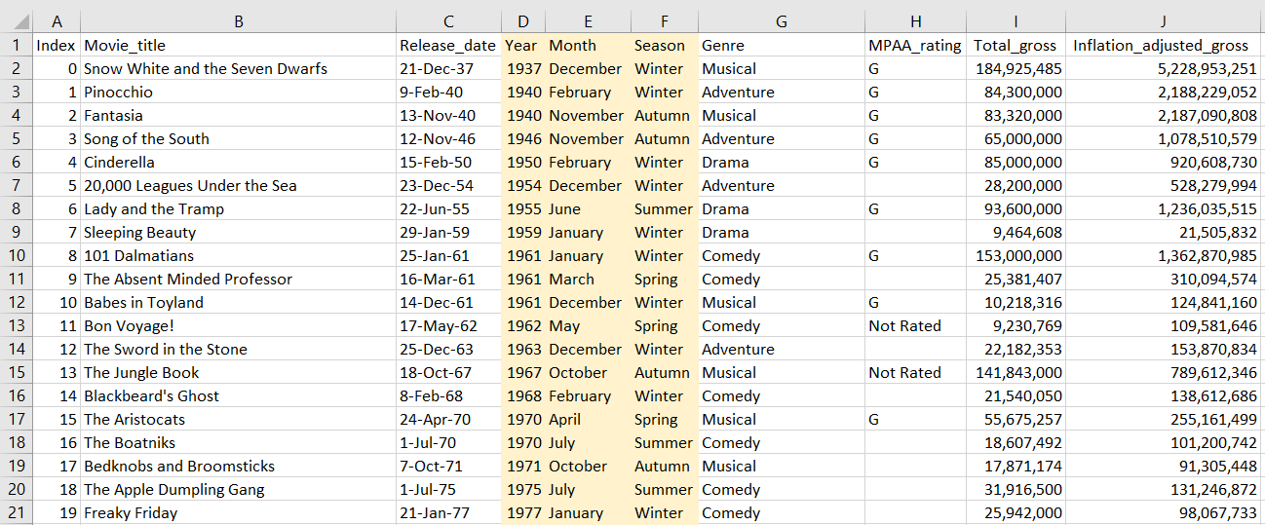
Dataset

Slide 3


Business Questions
Is there any relationship between inflation-adjusted gross and total gross for Disney movies?
How has the total gross revenue of Disney movies changed over the years?
Which genre is more prefered by people
Which are the top 15 highest-grossing Disney movies of all time?

Slide 4


Business Questions
How does the total gross of Disney movies vary by the movie rating?
How many Disney movies were released on each day of the week, and which day had the highest number of releases?
What is the distribution of Disney movie releases by season (winter, spring, summer, fall) over the years?
What are the most popular keywords used in Disney movie titles?
What are the top 5 highest-grossing Disney movies for each decade?

Slide 5
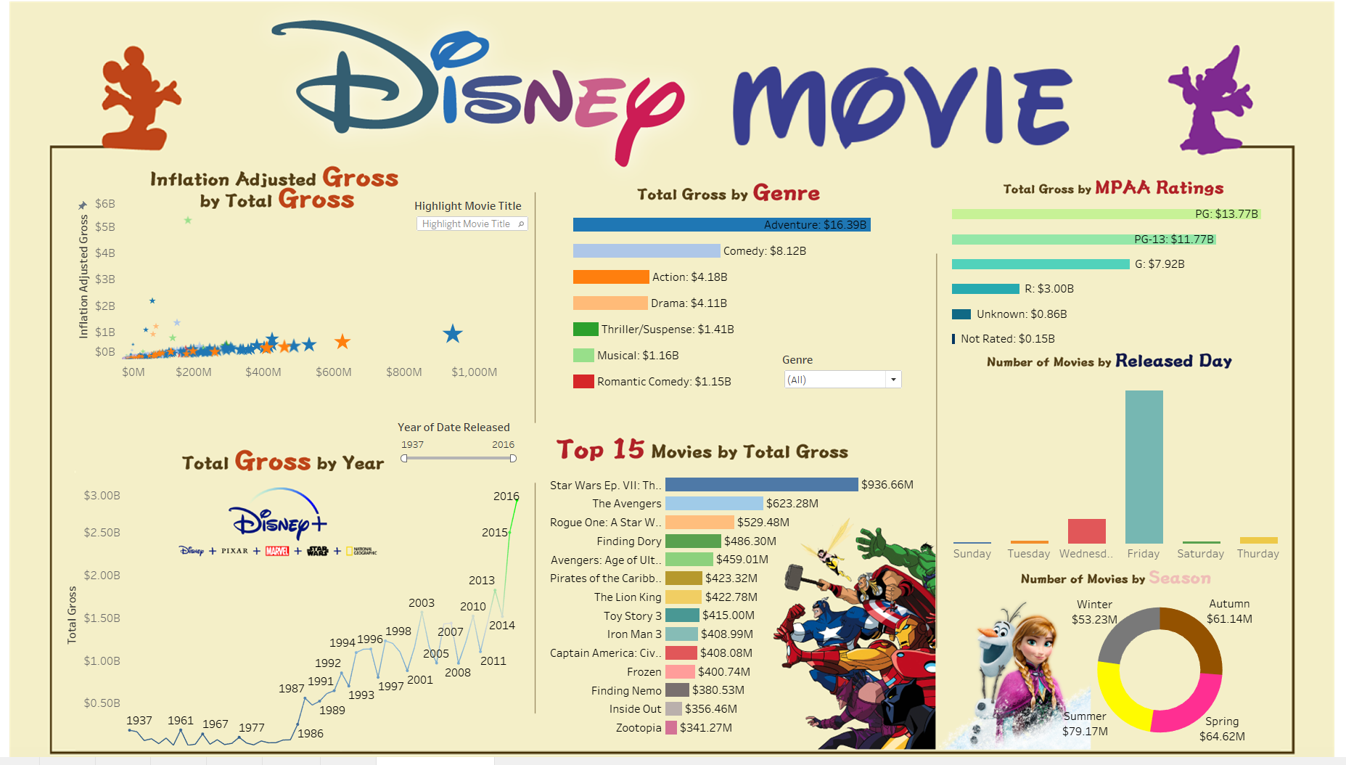
Notes:
Source: https://www.schemecolor.com/classic-disney.php
https://www.behance.net/gallery/25583667/Walt-Disney-World-Infographic
https://www.flaticon.com/search?word=mickey
https://www.pngegg.com/en/search?q=elsa
https://www.pngegg.com/en/search?q=snow+white
https://www.pngegg.com/en/png-wgaqe/download
https://www.pngegg.com/en/png-bymgo/download
https://www.pngegg.com/en/png-swdte/download
https://www.pngegg.com/en/png-felqx/download
https://www.kindpng.com/downpng/TxhbTJm_disney-plus-logo-png-transparent-png/
https://fontmeme.com/disney-font/

Slide 6

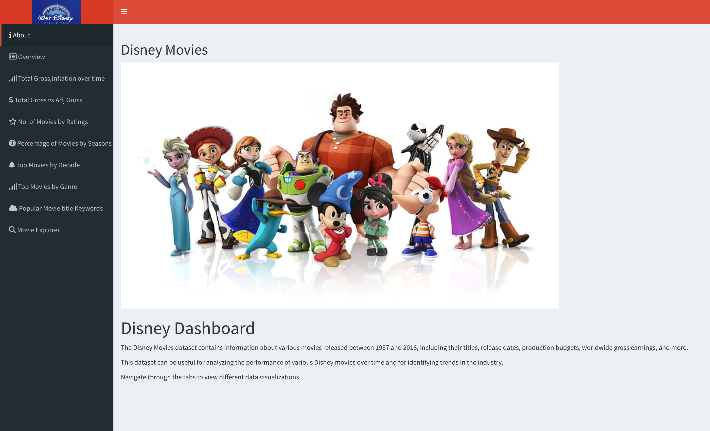

Slide 7
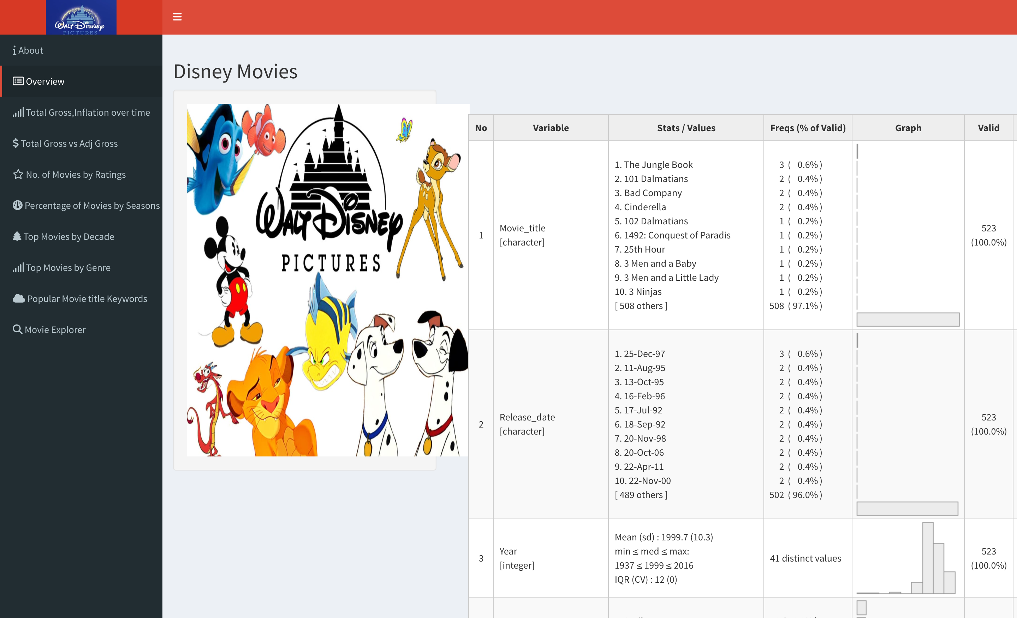

Slide 8
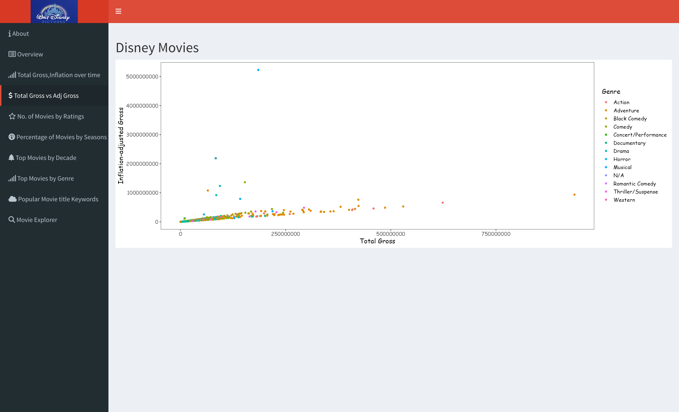

Slide 9
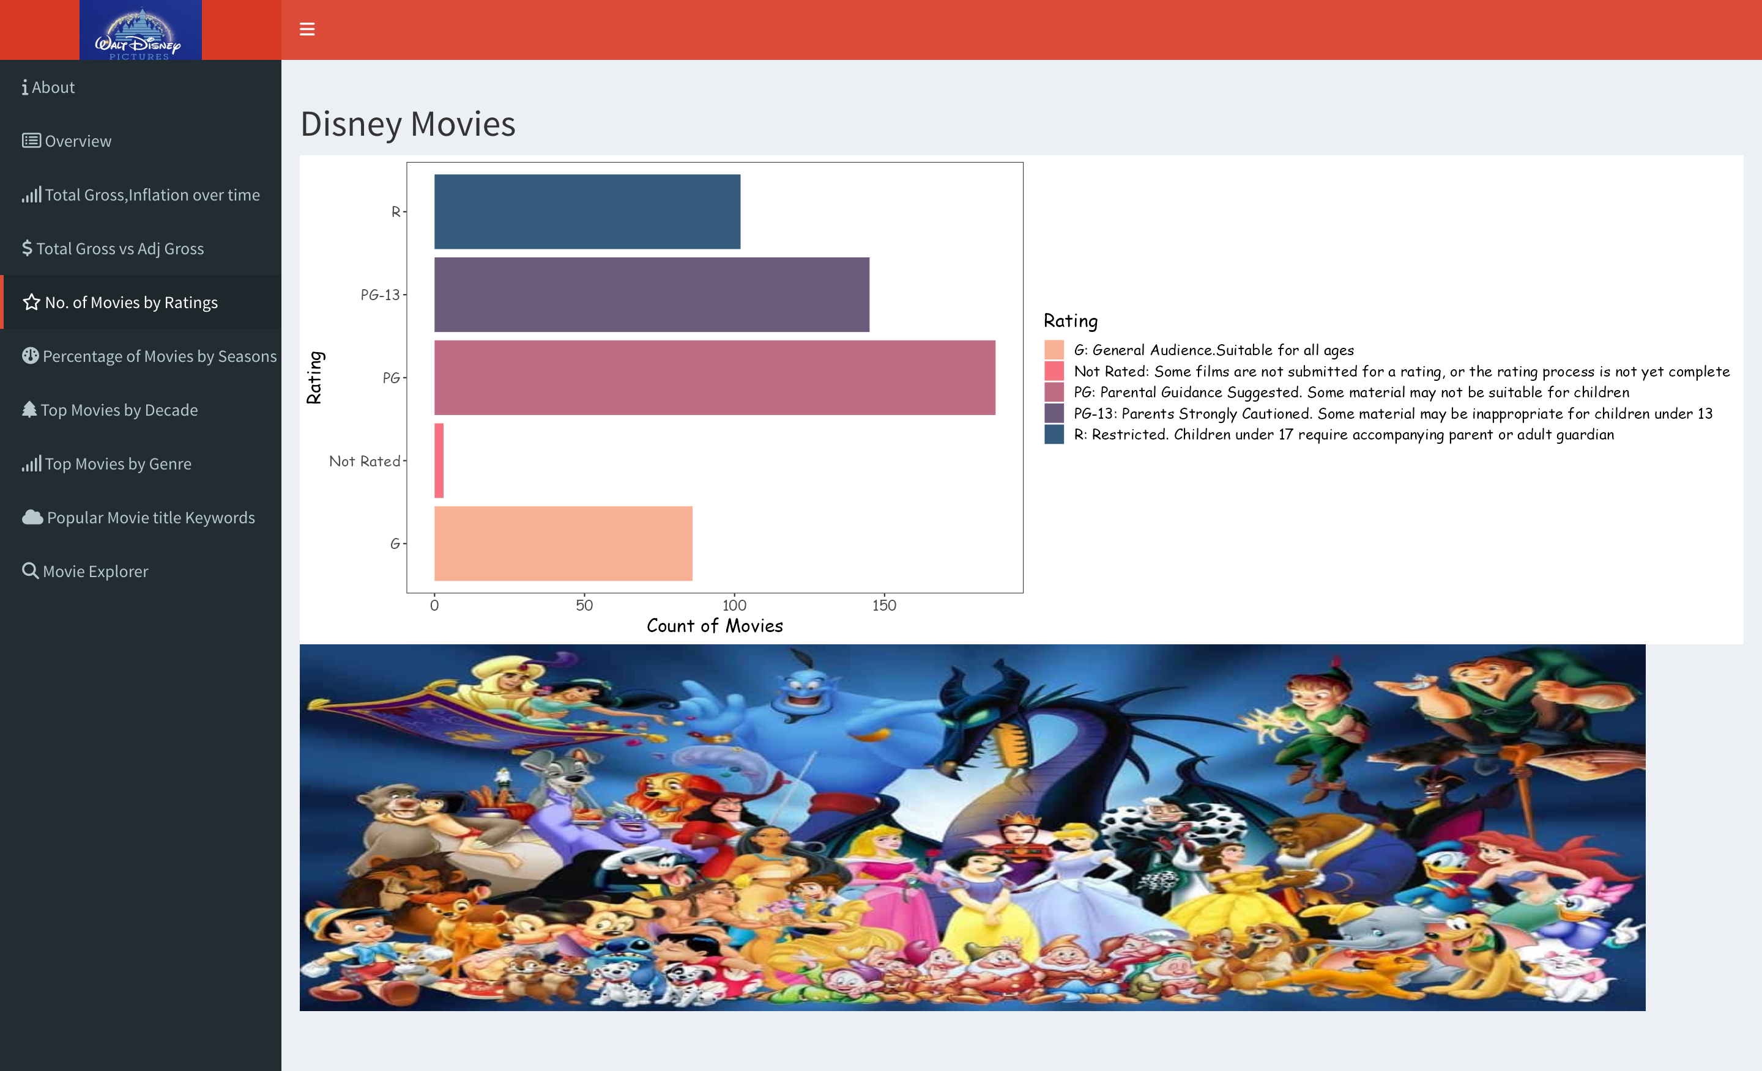

Slide 10
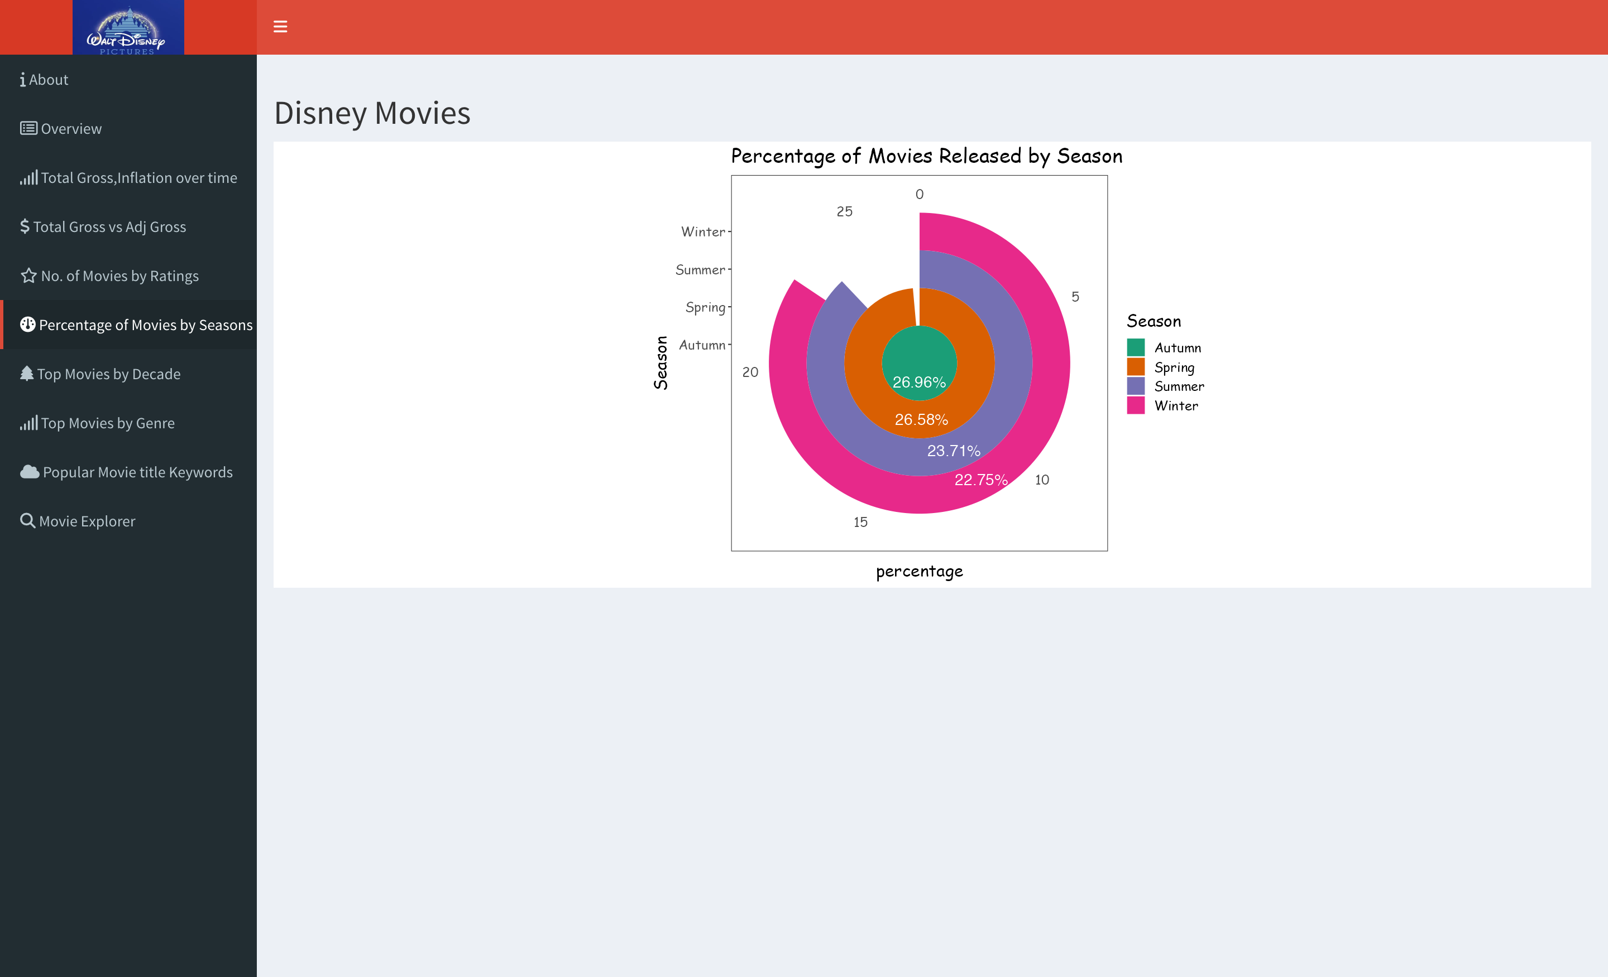

Slide 11
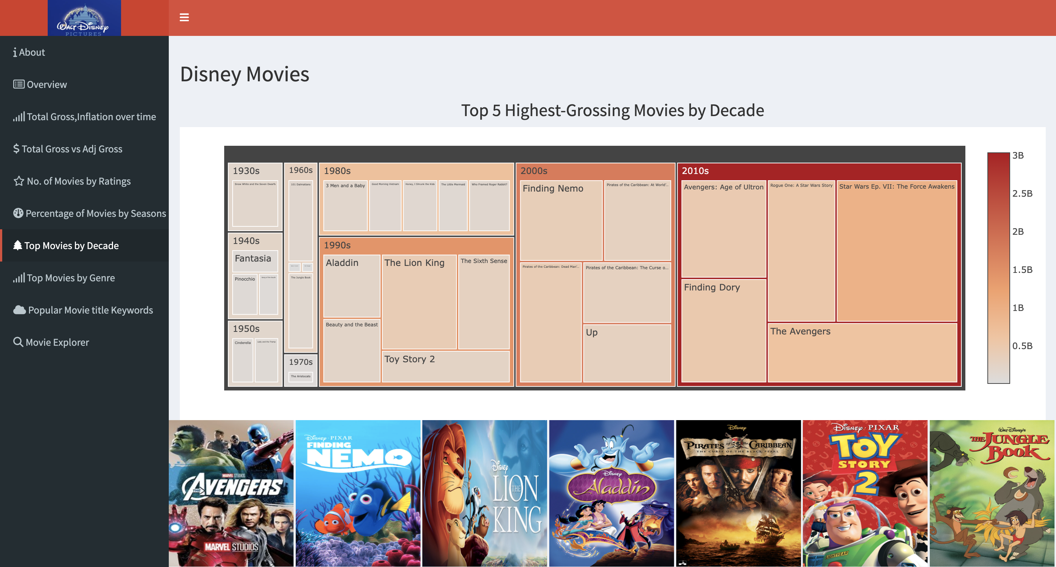

Slide 12
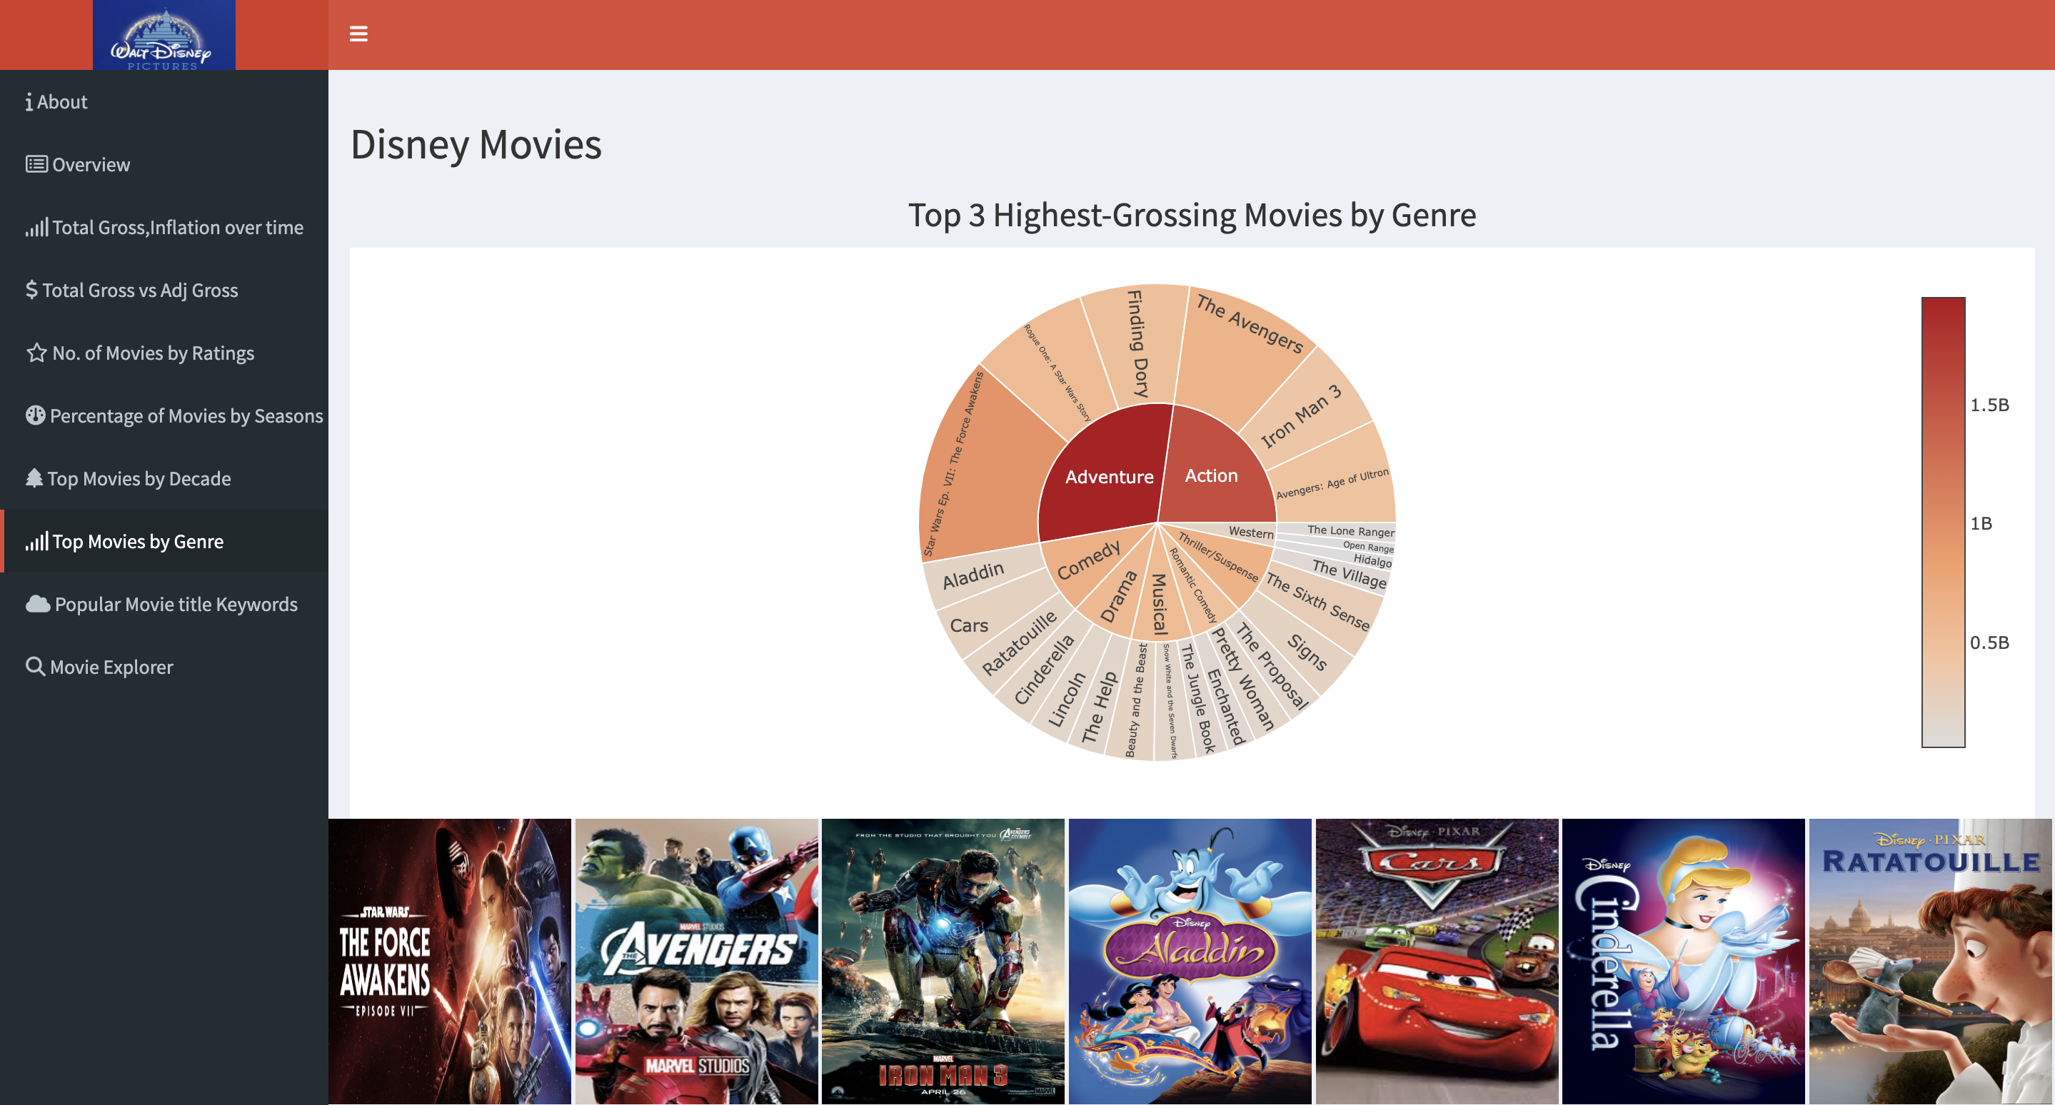

Slide 13
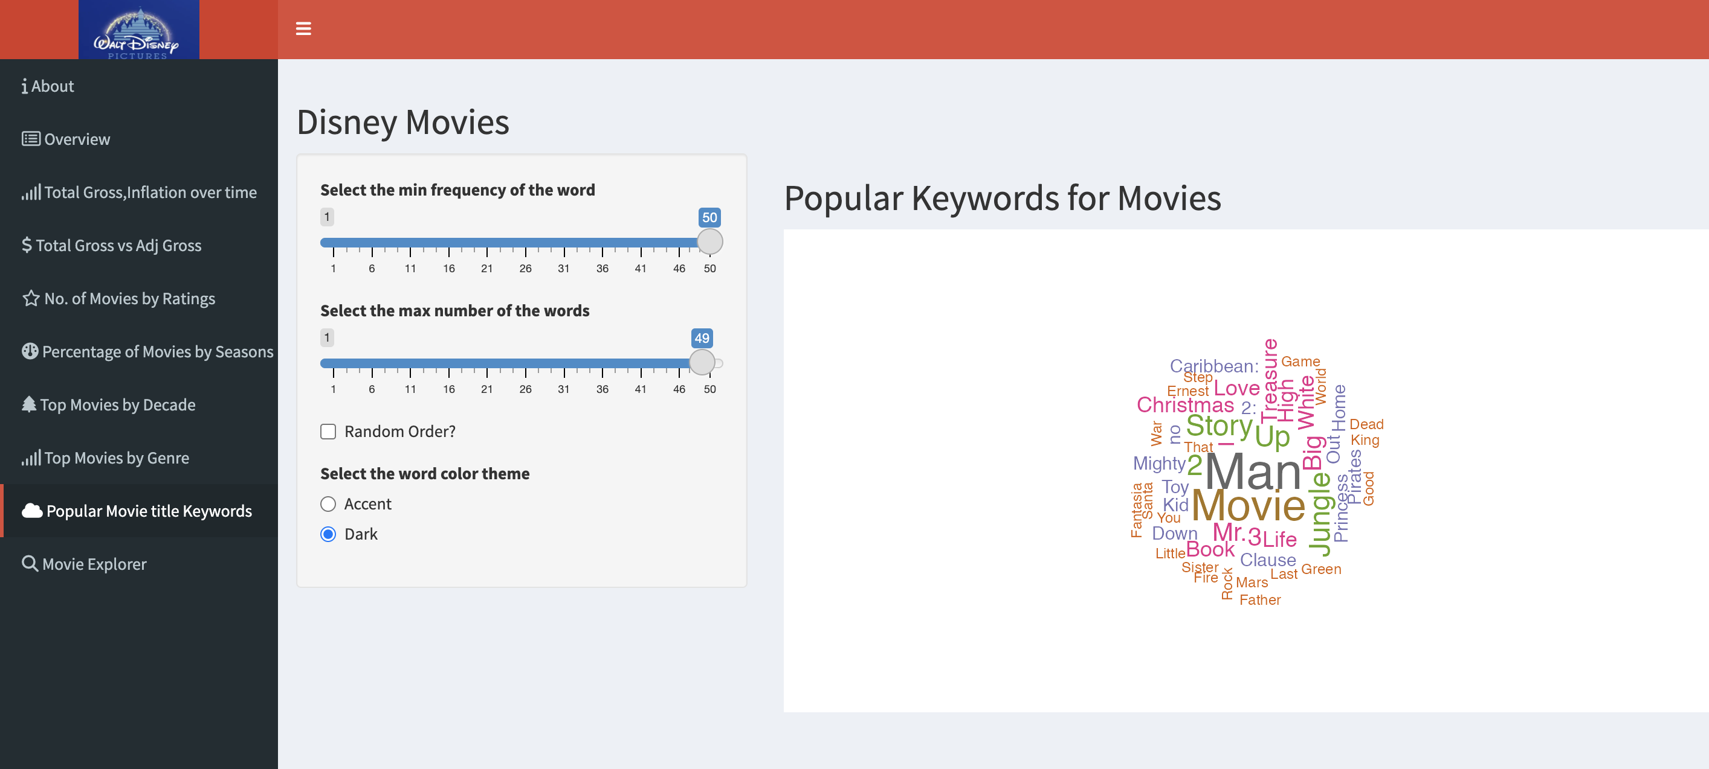

Slide 14
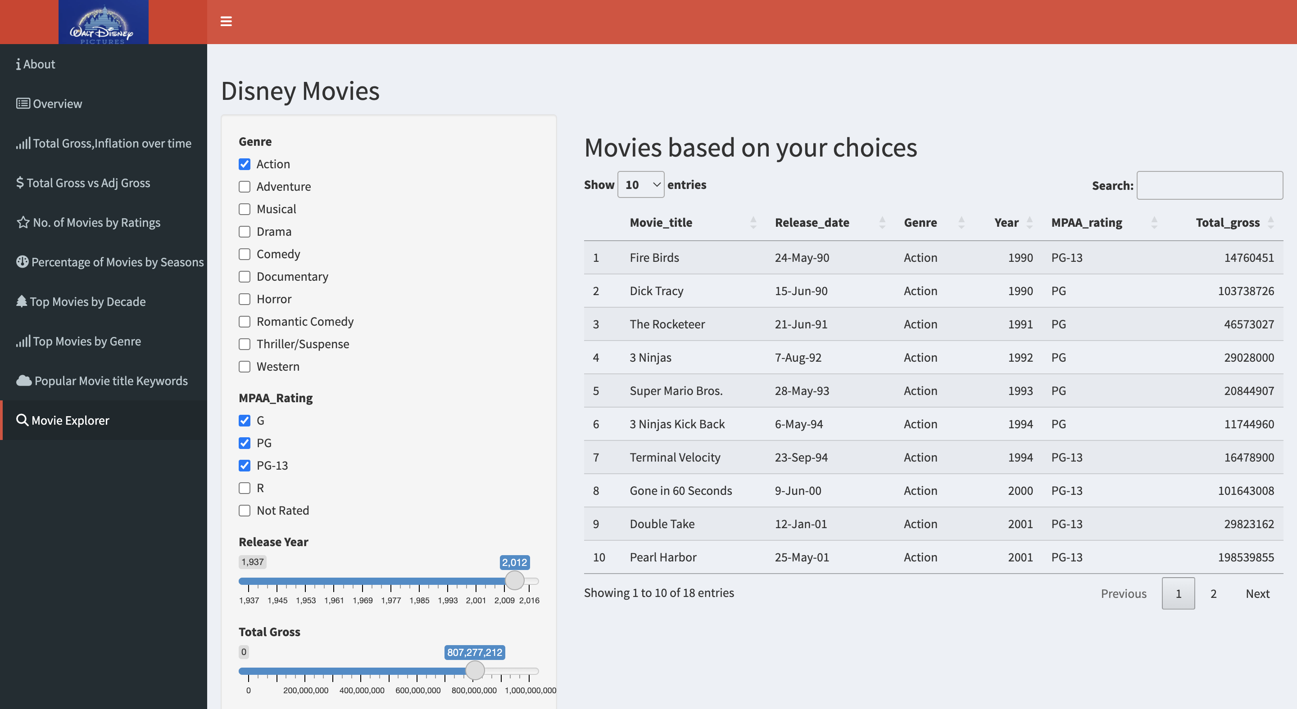

Slide 15
Conclusion & Insights
A consistent increase in total gross from 1937 to 2016, highlighting the growing success of Disney movies over time.
Adventure and comedy genres generated the highest revenue, indicating their strong appeal to audiences.
The Star Wars series and The Avengers were among the top-performing movies in terms of total gross.
PG-rated movies were the most successful in terms of revenue, emphasizing the popularity of family-friendly content.
Friday was the most common day for movie releases, suggesting a strategic approach to maximize box office potential.
Summer was the highest-grossing season, reflecting the impact of strategic release schedules and the appeal of blockbuster movies during this period.

Slide 16

Q&A

